Slide 1
CGB1201 – JAVA PROGRAMMING
Department of Artificial Intelligence and Data Science
Academic Year: 2024 – 2025 (Odd Semester)
Register Number :2303811724322124
Name :VISWADHARSHINI T.K
Year :II
Semester :III
Section :B
Date :3/12/24

Slide 2
Title of the Project
CAR RENTAL SYSTEM

Slide 3
Problem Identification
Complicated or lengthy booking processes can frustrate customers and lead to abandone
Customers may face uncertainty about car availability, leading to booking conflicts or customer dissatisfactiond reservations.
Errors in payment processing, unclear billing, or complicated payment methods can cause delays and dissatisfaction.

Slide 4
Objective
Enable users to easily search, book, and reserve cars online.
Provide real-time availability updates and ensure vehicles are well-maintained.
Display clear pricing with no hidden charges to build trust and customer satisfaction.

Slide 5
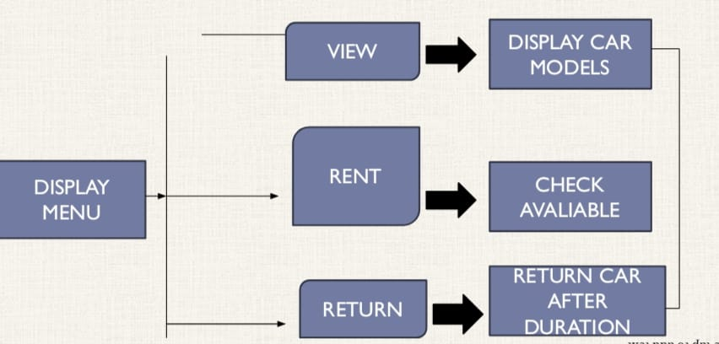
Proposed Architecture

Slide 6
Java Programming - Concepts Used
1.Object-Oriented Programming (OOP)
2.Exception Handling
3.File I/O (Input/Output)
4.JDBC (Java Database Connectivity)

Slide 7
List of Modules
1. User Management Module
2. Car Inventory Module
3. Booking Management Module
4. Reporting Module

Slide 8
Module Description (Cont..)
3. Booking Management Module:
Search Cars: Customers can search for cars based on their preferences (e.g., type, price, availability).
Booking: Represents a booking with attributes such as bookingId, carId, customerId, startDate, endDate, totalPrice.
4. REPORTING MODULE
Provides details of all bookings, including customer information, rental duration, and payment status.

Slide 9
Module Description
1. User Management Module:
User Registration: New customers can create accounts by providing personal details such as name, email, and password.
User: Represents the user entity with properties like userId, name, email, password.
2. Car Inventory Module:
Add/Update Car: Admins can add new cars to the system or update the details of existing cars (e.g., model, rental price, availability).
Car: Represents the car entity with attributes like carId, make, model, year, pricePerDay, availability.

Slide 10
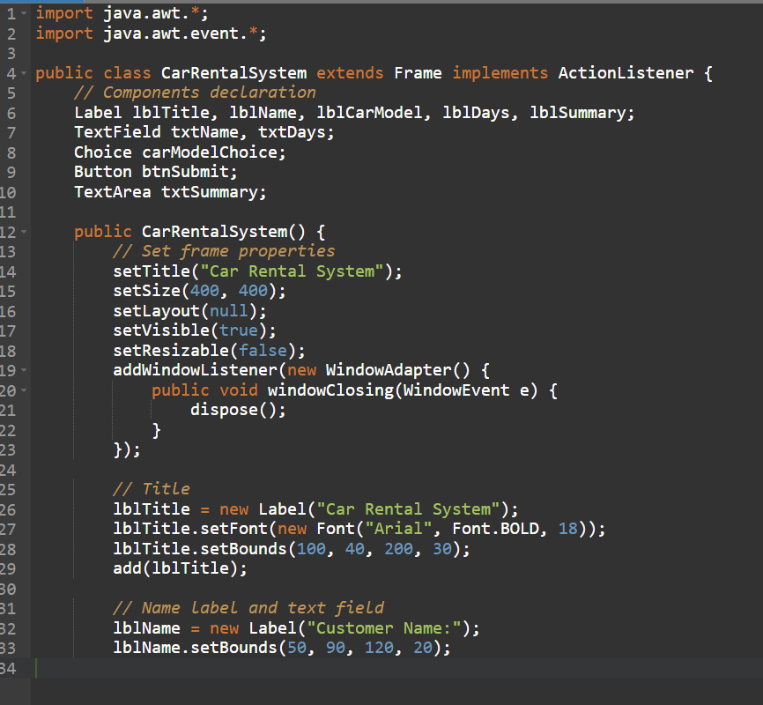
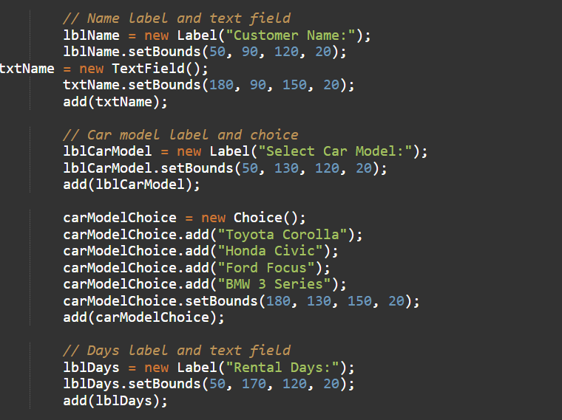
Source Code

Slide 11
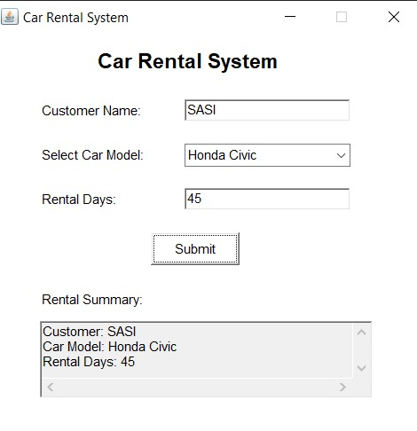
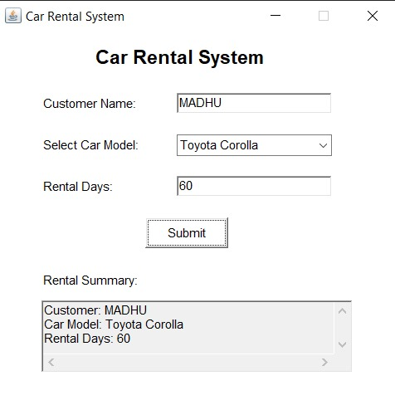
Results

Slide 12
Conclusion
* The Car Rental System is a comprehensive solution designed to simplify and streamline the process of renting vehicles. By automating key functions such as booking, payment, vehicle management, and customer service, this system provides a user-friendly platform that benefits both customers and rental agencies.
* Customers can easily browse available cars, check rental prices, and book vehicles according to their preferences, ensuring a smooth rental experience.

Slide 13
Thank You
ANY QUERIES???

